Slide 1
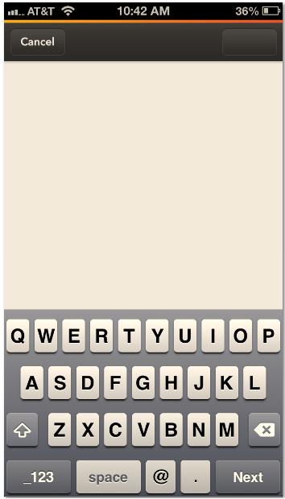
Share to Facebook (UI on iPhone)
Facebook
Share
Facebook app gains faster events, better Places editing, new photo viewer button
- shared from GageIn, a visual sales intelligence company

Slide 2
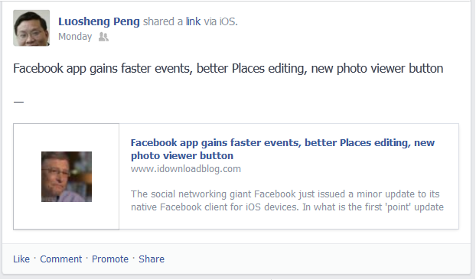
How does it look like on Facebook
shared from GageIn, a visual sales intelligence company

Slide 3
Share to LinkedIn (UI on iPhone)
LinkedIn
Share
Facebook app gains faster events, better Places editing, new photo viewer button - shared from GageIn, a visual sales intelligence company
633

Slide 4
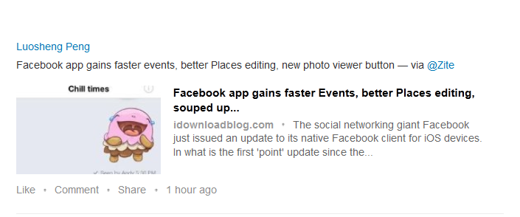
How does it look like on LinkedIn
Facebook app gains faster events, better Places editing, new photo viewer button - shared from GageIn, a visual sales intelligence company

Slide 5
Share to LinkedIn (UI on iPhone)
Twitter
Share
Facebook app gains faster events, better Places editing, new photo viewer button <news URL> via @GageIn
52

Slide 6
How does it look like on LinkedIn
Facebook app gains faster events, better Places editing, new photo viewer button - shared from GageIn, a visual sales intelligence company

Slide 7

Facebook app gains faster events, better Places editing, new photo viewer button <news url> via @GageIn

Slide 8
Similar to Facebook on Salesforce/Chatter and Yammer

